Slide 1

Real Estate Analysis
Joshua Edelstein

Slide 2

Agenda
1. Address Stakeholder
2. Data Background
3. Predictive Model
4. Conclusion/ Recommendations
5. Next Steps

Slide 3
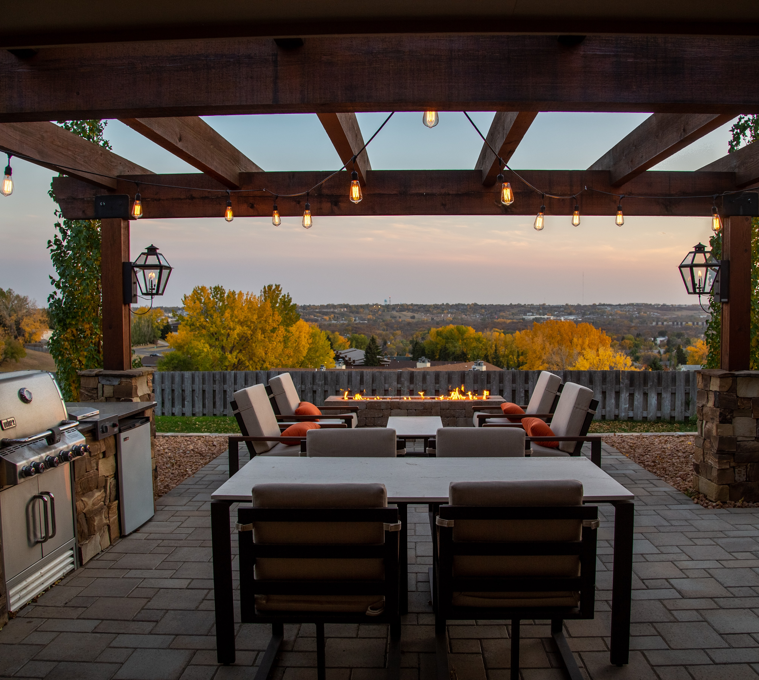
Business Question
King of the Deck Co.
Expand Business
Ideal Deck Size
Notes:
Photo by Arcwind on Unsplash

Slide 4
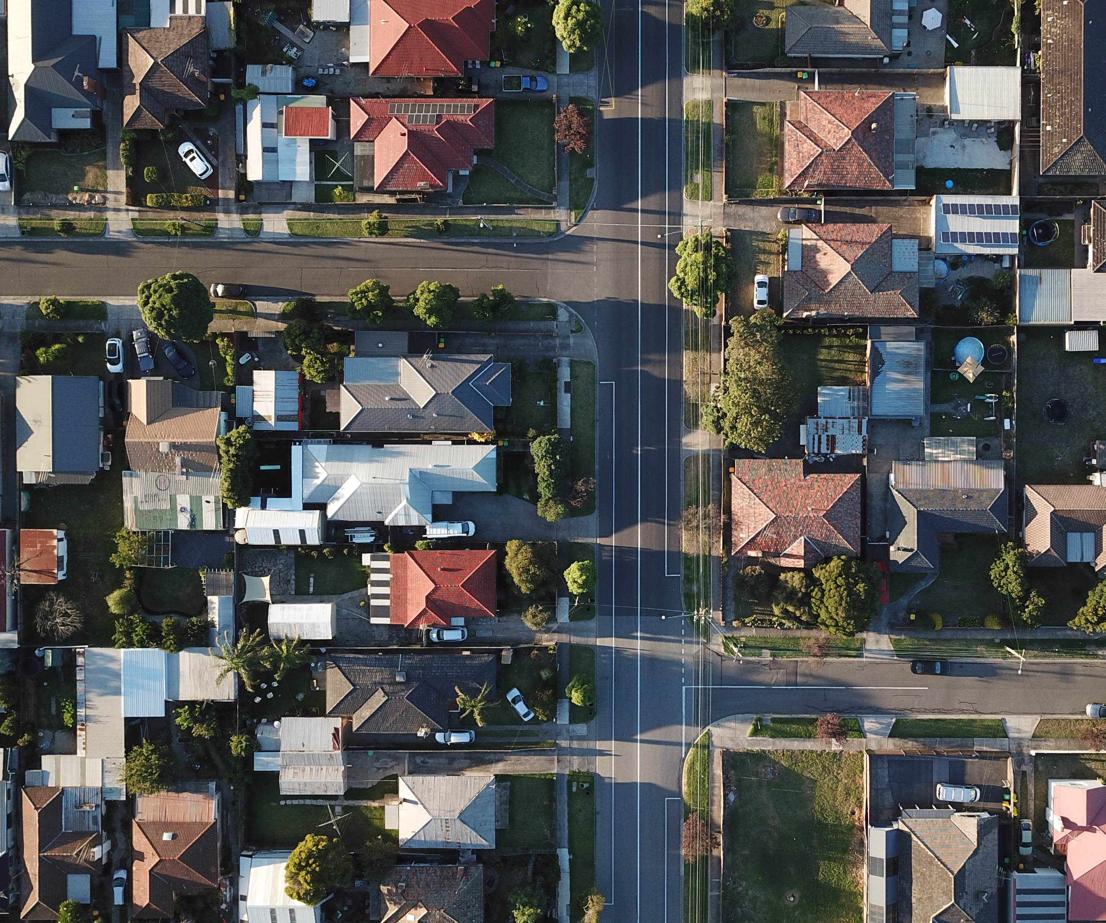
Data Understanding
Over 30,000 within USA
Sold in 2021-2022
Built 1900-2022
Notes:
Photo by Tom Rumble on Unsplash

Slide 5
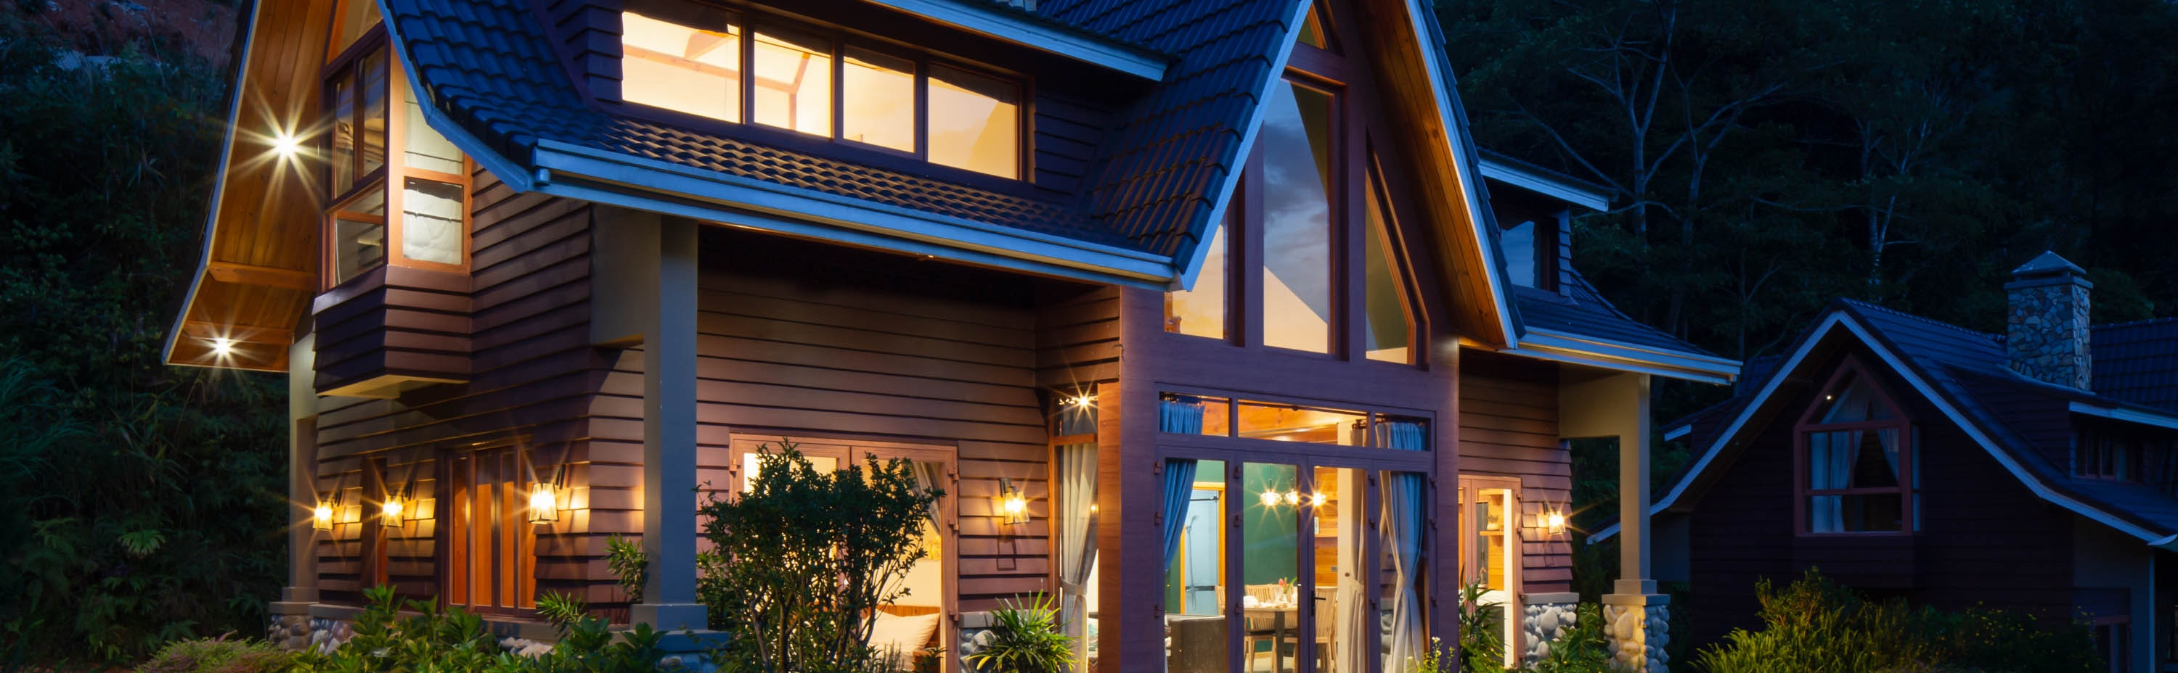
Data Understanding
Data Information
Numeric (Square Footage, bedrooms, bathrooms, etc.)
Categorical (View, Condition, Noise, etc.)
Notes:
Photo by vu anh on Unsplash

Slide 6

Modeling
Notes:
Regression model benefit is that it shows which individual factors affect price, and how much, and can control for different factors

Slide 7
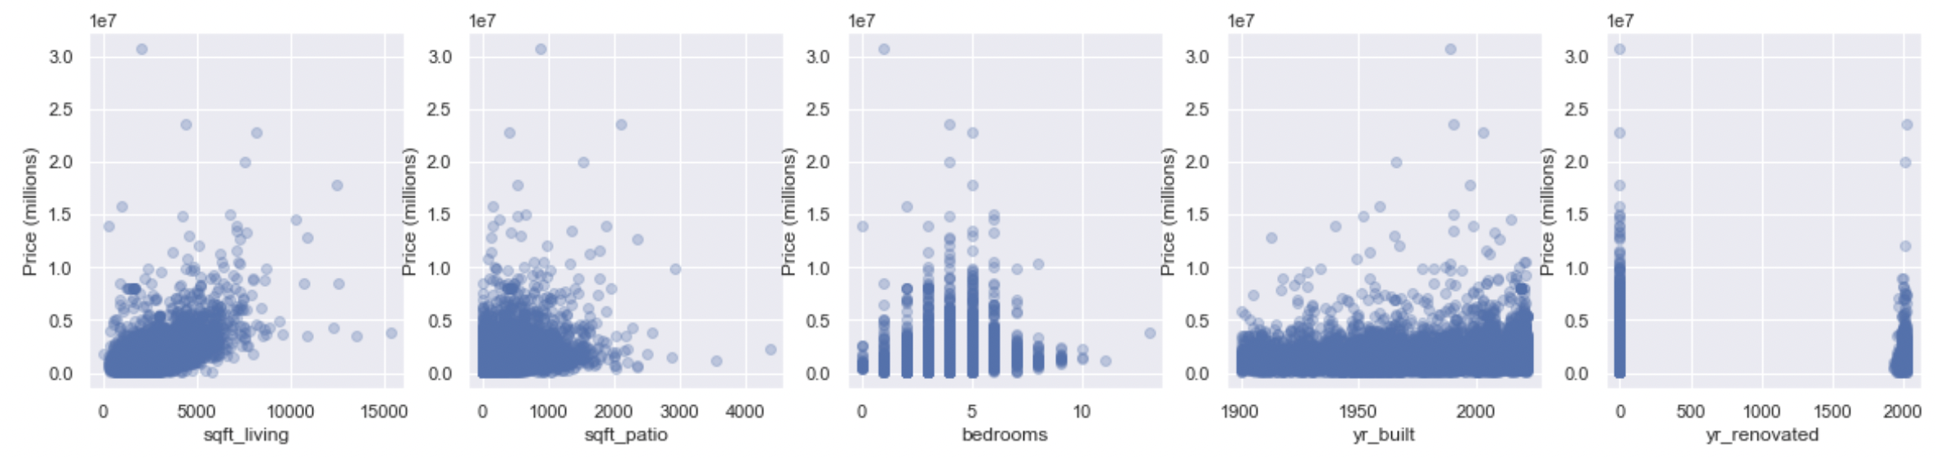
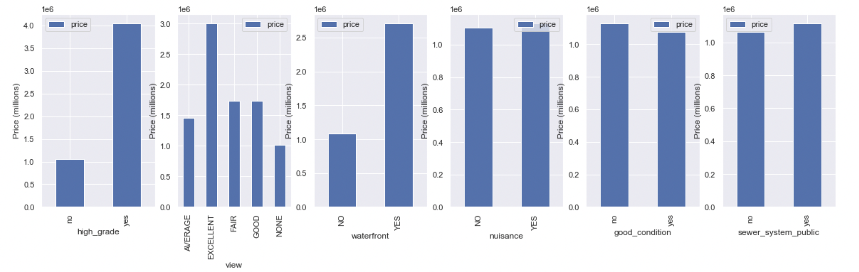
Modeling
Factors:
Notes:
(aka how accurate the model is at predicting)

Slide 8


Modeling
Adjusted R Squared: 68%
Average predictions off by 22%
Accurate within 2 standard deviations
Middle 95% of the data
High and Low Priced Houses
Notes:
(aka effectiveness of the model is at predicting)
MAE over RMSE bc we didn’t want model so sensitive to outliers

Slide 9

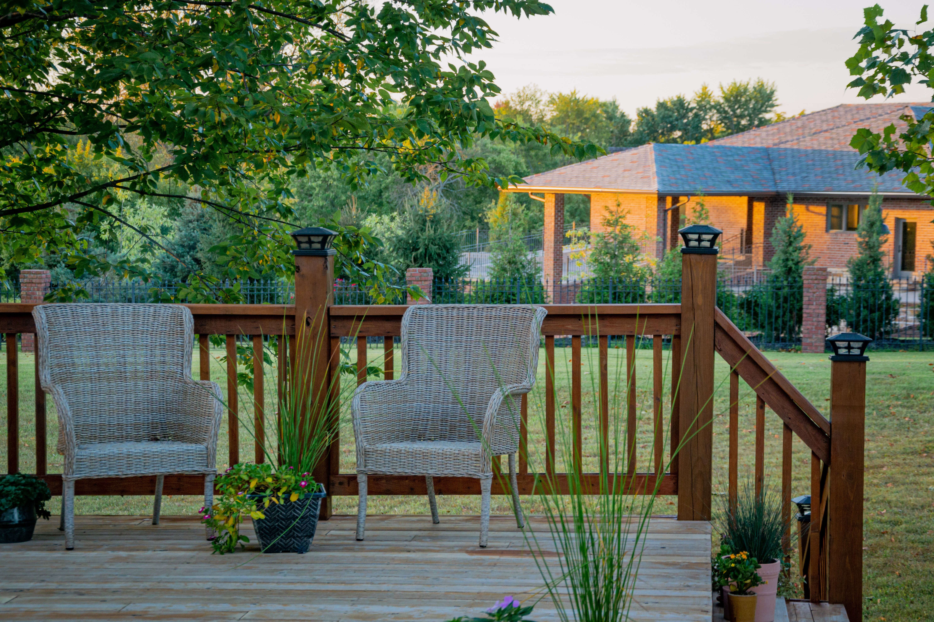
Regression Results
Square Foot Living Area:
.03% gain
Square Foot Patio:
.006% gain
Notes:
Photo by Minh Pham on Unsplash
Photo by Ralph (Ravi) Kayden on Unsplash

Slide 10
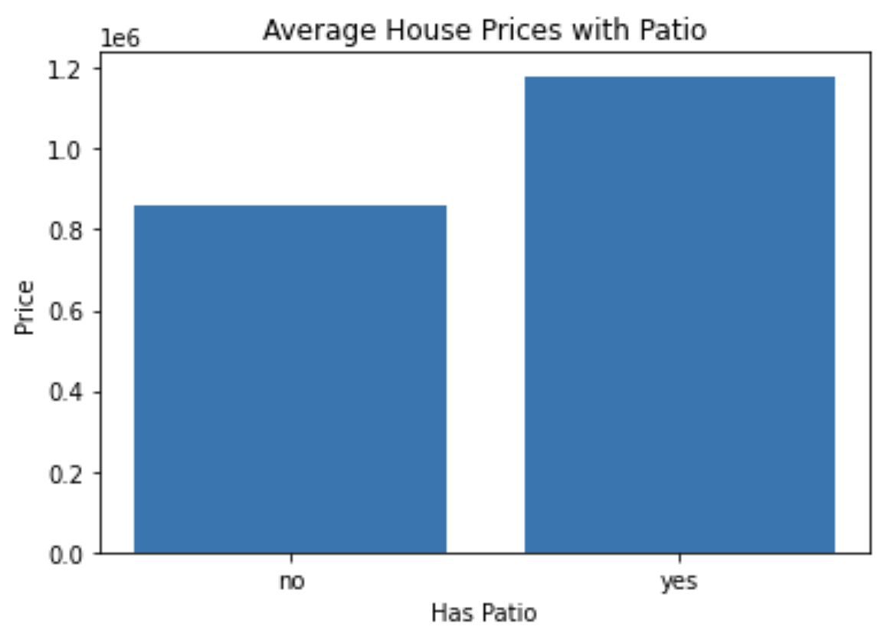
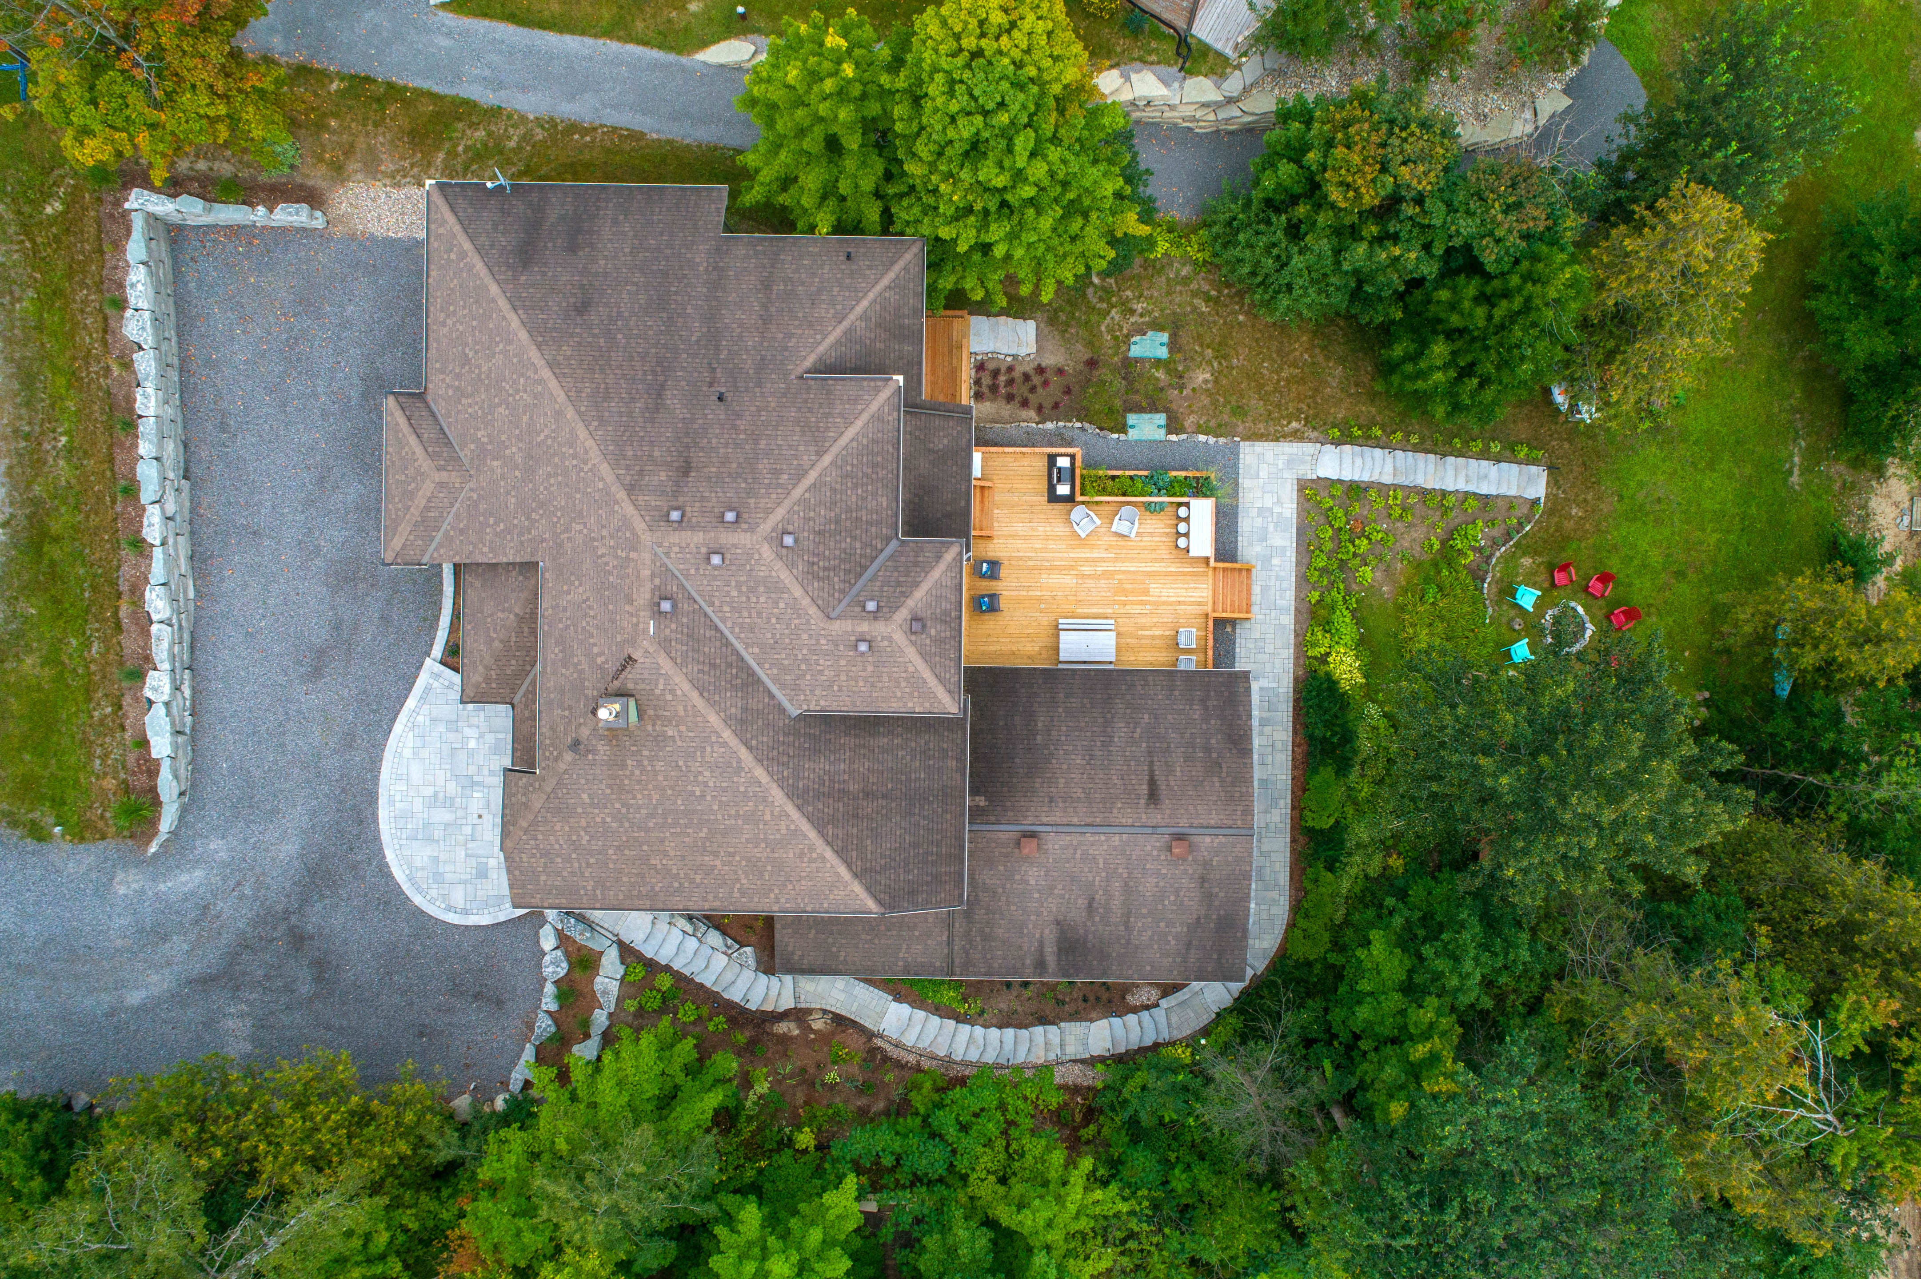
Deck Statistics
Patio adds value to House
Patio vs Living Area
~10%
Patio vs Lot Size
~3%
Notes:
Photo by Point3D Commercial Imaging Ltd. on Unsplash

Slide 11

Recommendations
Consider Expanding
Deck adds value:
Lower Cost
Less Headache
Size
10% of Living Area
3% of Lot Size
Indoor Renovations

Slide 12
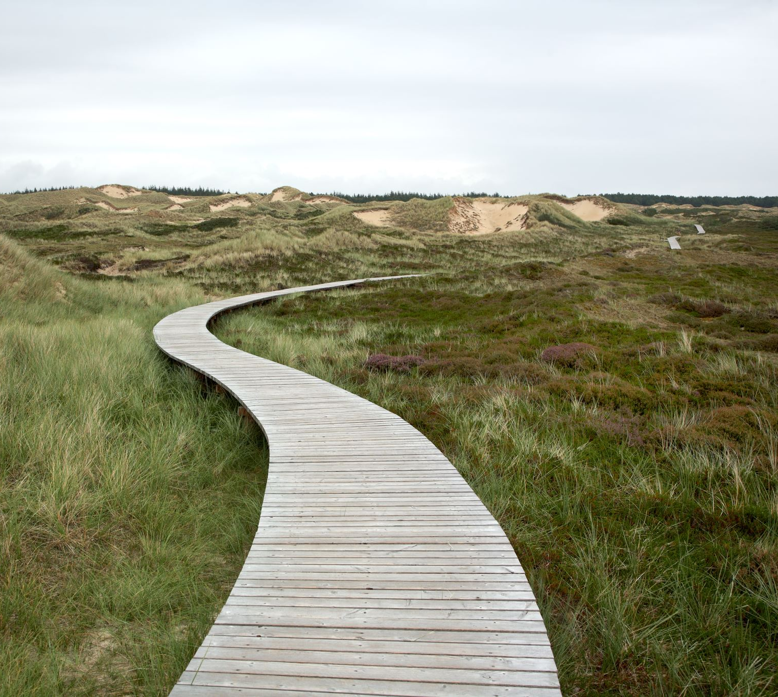
Next Steps
Option I
Look into deck materials
Profitability
Add value
Aesthetically pleasing

Slide 13
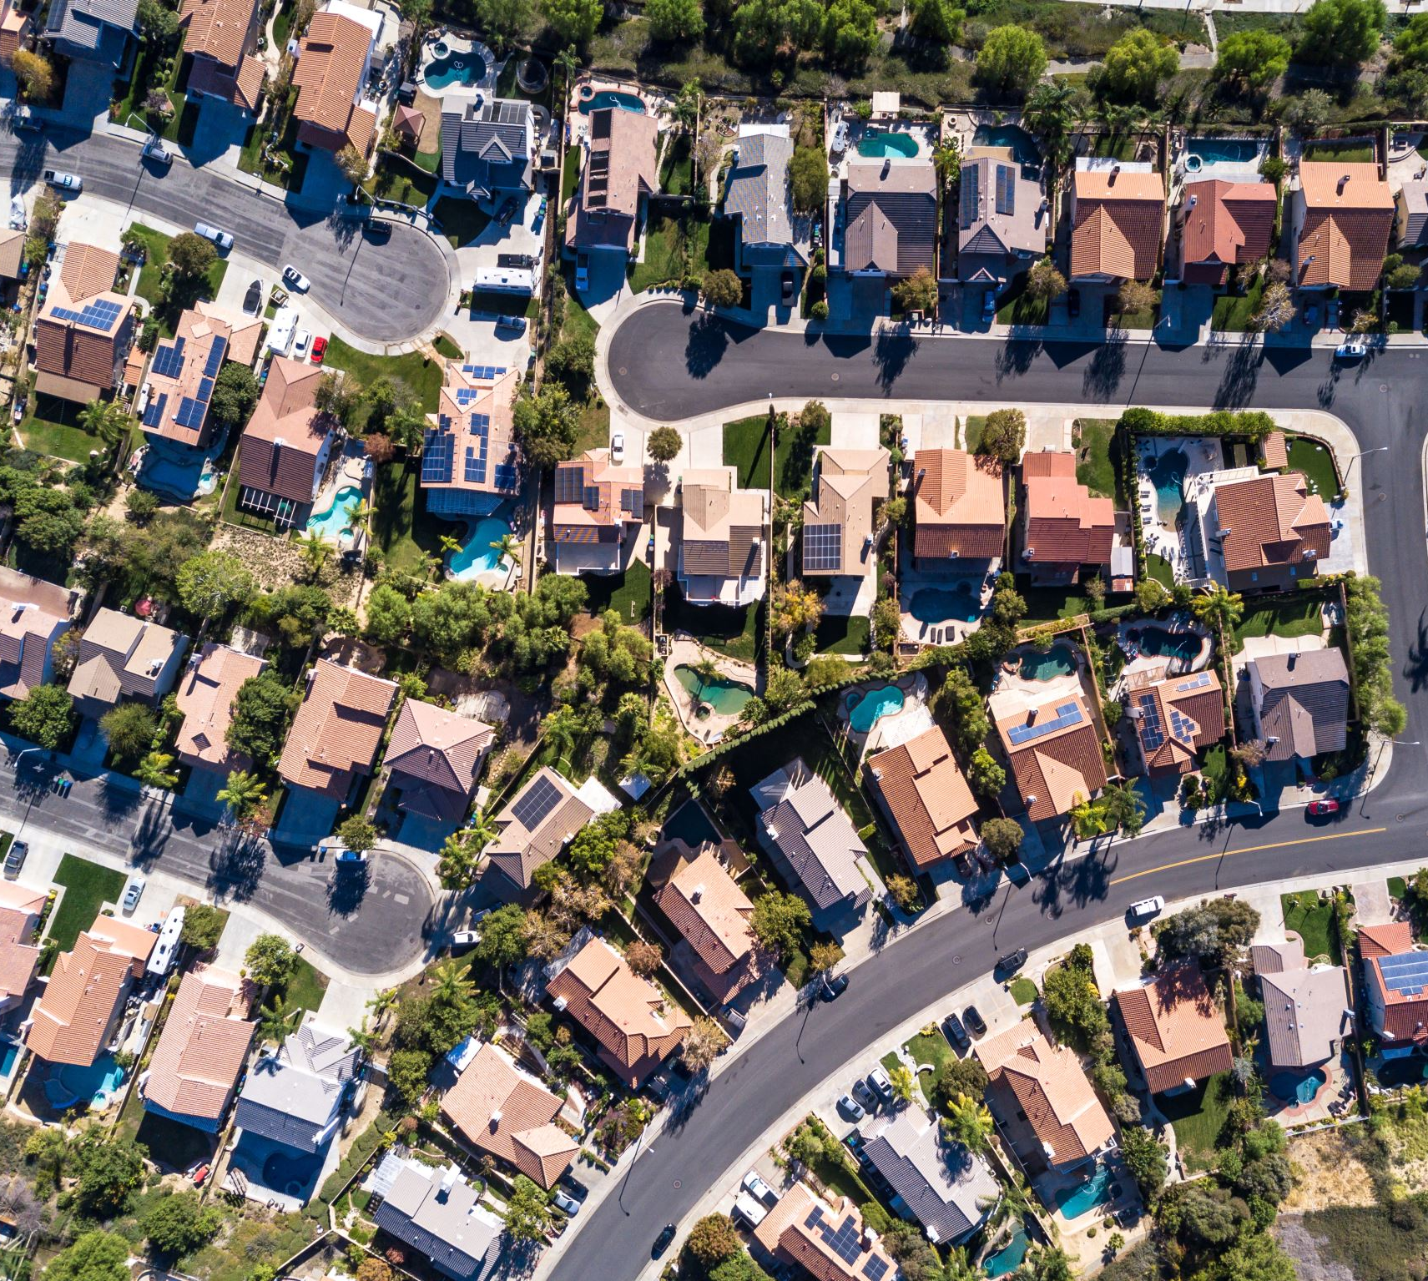
Next Steps(II)
Option II
Create more accurate model with more Data:
House of worship
Proximity to parks
Landscaping (pool, courts, green area)
Social and Economic Factors

Slide 14

Thank You
Joshua Edelstein
Notes:
Photo by Collov Home Design on Unsplash

